Slide 1
Modernizing Applications with Containers and Orchestrators

Slide 3
Module 5 – Container Orchestrators

Slide 4
Agenda
What is orchestration?
Microsoft offerings for containers
Azure Container Instance
Service Fabric
Additional options for orchestration
Introduction to Kubernetes
Introduction to MiniKube
Notes:
We are going to talk about what orchestration is
Why this is important/useful?
Present solutions in Azure to work with microservices and containers:
AKS – managed Kubernetes service
Azure Container Service (With different orchestrators: Kubernetes, Swarm, DC/OS)
Azure Container Registry
Azure Service Fabric – orchestrator + programming model
Azure Container Instances

Slide 5
Challenges of a containerized world
As application development has moved towards a container-based approach, the need to orchestrate and manage the inter-connected resources becomes important
Load Balancing
Distributing traffic across containers at scale
Naming and Discovery
How do containers or groups find one another?
Logging and Monitoring
Keeping track of what containers are doing
Debugging and Introspection
Getting inside running containers
Networking
Differentiating container networks from host networks at scale
Notes:
“Container-centric infrastructure”
Additionally: configuration management, debugging/introspection, identity and authorization
First of all.. You can run containers w/o any further infrastructure. Docker, Images and Go..
But you’ll super quickly face issues – for example
how to distribute containers in a cluster?
Where to start my Containers?
What happens when a container or a container host failed?
How to I distribute requests across multiple instances of an application or service?
How to measure and how to scale applications based on load?

Slide 6
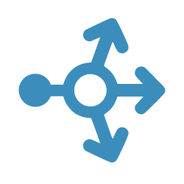
Application Scale
Web
Web
Web
Web
Web
API
API
API
Cache
Cache
Notes:
Here is a typical web environment <CLICK>
But we need to scale this <CLICK> <CLICK>
Add a load balancer <CLICK>
How would you configure an environment like this? Today you would need to configure a load balancer and add static ip addresses ext…..
This would not work in this environment where machines (containers) are constantly being moved around, added and deleted.
<CLICK>

Slide 7
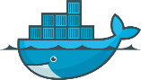
Load Balancing & Fault Tolerance
DOCKER_HOST
Docker daemon
Containers
Image Cache
Web
Web
Web
Web
Web
Web
API
Cache
API
API
API
Cache
Cache
Notes:
Should all these containers be on a single host?? Probably not <CLICK>

Slide 8


Distribution
DOCKER_HOST
DOCKER_HOST
Docker daemon
Docker daemon
Containers
Image Cache
Containers
Image Cache
Container Scheduling
Container Orchestration
DOCKER_HOST
DOCKER_HOST
DOCKER_HOST
DOCKER_HOST
Docker daemon
Docker daemon
Docker daemon
Docker daemon
Containers
Image Cache
Containers
Image Cache
Containers
Image Cache
Containers
Image Cache
Web
Web
Web
Web
Web
Web
Cache
API
Cache
Web
Web
API
Cache
API
Cache
API
API
API
Cache
Cache
Notes:
So what we need is to have multiple hosts. <CLICK>
And distribute the containers to theses hosts in such a way that any single host failure will not bring down the entire application <CLICK>
Services (Load Balancers) are distributed across the cluster with access to each container it manages <CLICK>
However, So when a host fails <CLICK>
The application can continue while the faulted containers are rebuilt on other hosts. <CLICK>
Orchestration is the automation of the monitoring and rebuild process, so we don’t have to. <CLICK>
A scheduler is software that tells the orchestrator how and when to stand up new environments. <CLICK>
The Orchestration and Scheduling is typically handled by the Control Plane (Master Node) <CLICK> with a Primary VM and a Failover VM in case the primary fails.

Slide 9
The elements of orchestration
Scheduling
Affinity/anti-affinity
Health monitoring
Failover
Scaling
Networking
Service discovery
Coordinated app upgrades
Notes:
Hence, why we need an orchestrator:
Automates the deployment, management, scaling, networking, and availability of containers
Manages the lifecycle of containers in large environments
Allow users to guide container deployment and automate updates, health monitoring, and failover procedures

Slide 10
Clustering versus orchestration
Clustering
Grouping “hosts”—either VMs or bare metal—and networking them together
A cluster should feel like a single resource rather than a group of disparate machines
Orchestration
Managing and monitoring of the workloads running in your cluster
Starting containers on appropriate hosts and connecting them
May also include support for scaling, automatic failover, and node rebalancing
Notes:
It is interesting to differentiate clustering and Orchestration.
Clustering: is how to group HW resources together as a single component to manage => the cluster. And connect them
Orchestration: To manage/monitor workloads running in your cluster.
Management operations like automatic failover, scale out, resource balancing, resource/placement constraint, rolling upgrade

Slide 11
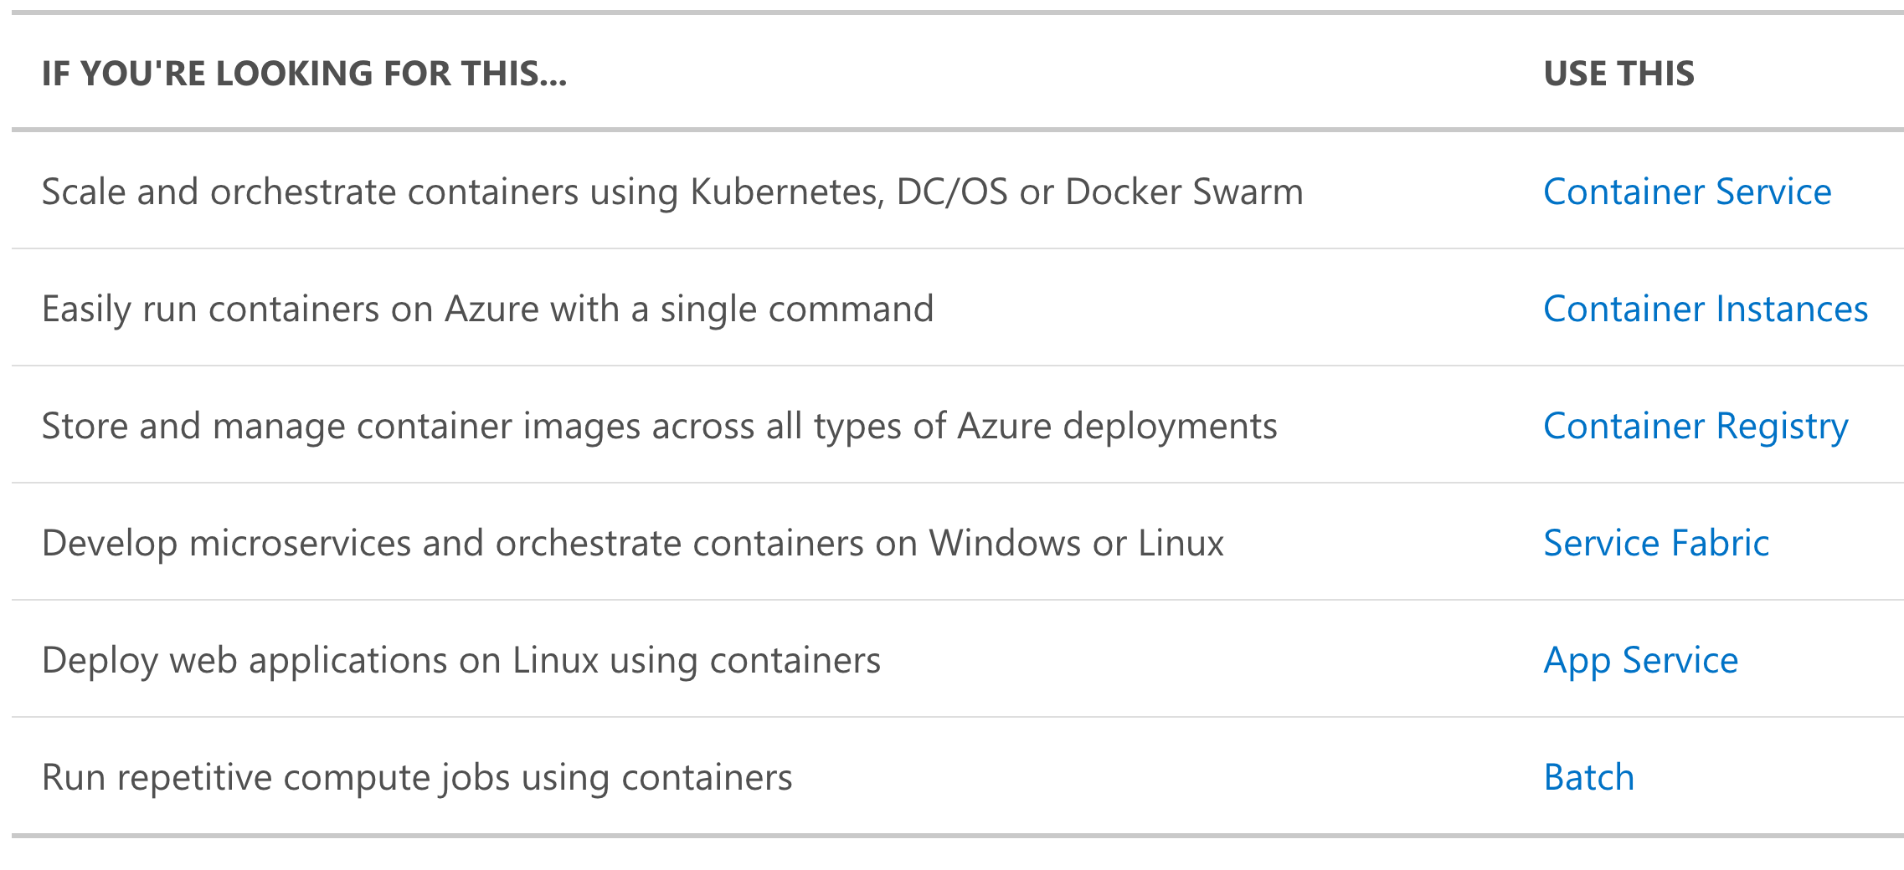
Microsoft Offerings for Containers
Kubernetes Service
Notes:
One pager summarizing Azure offering in term of container and orchestration:
AKS: Like ACS but the Control Plane (master node) is provided in a PaaS => no master node to manage/update => No Windows container support yet
Container Instances : single command line to run containers – just for experimentation purpose or burstable workload (scale our AKS with virtual Kubelet). No access to VM/network
Container Registry to store container images
Service Fabric: clustering platform, orchestrator, programming model (stateless, stateful, actor pattern)
App Service – Run a single container application in Azure App Service (Linux only)
Azure Batch for repetitive compute jobs that can be parallelized.
Touch on the fact AKS can now support Windows Containers
ner support yet
Container Instances : single command line to run containers – just for experimentation purpose or burstable workload (scale our AKS with virtual Kubelet). No access to VM/network
Container Registry to store container images
Service Fabric: clustering platform, orchestrator, programming model (stateless, stateful, actor pattern)
App Service – Run a single container application in Azure App Service (Linux only)
Azure Batch for repetitive compute jobs that can be parallelized.

Slide 12
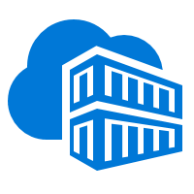
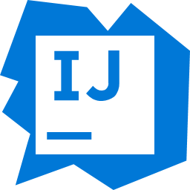

Azure App Service
Easily deploy and run container-based web apps at scale
Accelerated outer loop
Fully managed platform
Flexibility & choices
Tight integration w/ Docker Hub, Azure Container Registry
Automatic scaling and load balancing
From CLI, portal, or ARM template
Built-in CI/CD w/ Deployment Slots
High availability w/ auto-patching
Single Docker image, multi container w/ Docker Compose
Intelligent diagnostics & troubleshooting, remote debugging
Backup & recovery
IntelliJ, , Jenkin, Maven Visual Studio family
Notes:
It has never been easier to deploy container-based web apps. Just pull container images from Docker Hub or a private Azure Container Registry, and Web App for Containers will deploy the containerized app with your preferred dependencies to production in seconds. The platform automatically takes care of OS patching, capacity provisioning, and load balancing.
Automate and simplify your container image deployments through continuous integration/continuous deployment (CI/CD) capabilities with Docker Hub, Azure Container Registry, and Azure DevOps/GitHub Action. App Service creates an association with the selected repository, so your apps are updated each time your source code changes. Schedule performance and quality tests in staging environment, and use deployment slots to swap staging to production in seconds, or roll back to previous versions without downtime.
Automatically scale vertically and horizontally based on application needs. Granular scaling rules are available to handle peaks in workload automatically while minimizing costs during off-peak times. Deploy data and host services across multiple locations with just few mouse clicks.
Azure App Service enables you to build and host web apps, mobile back ends, and RESTful APIs in the programming language of your choice without managing infrastructure. It offers auto-scaling and high availability, supports both Windows and Linux, and enables automated deployments from GitHub, Azure DevOps, or any Git repo. Learn how to use Azure App Service with our quickstarts, tutorials, and samples.
Create a multi-container (preview) app using a Docker Compose configuration
Windows containers in preview
https://docs.microsoft.com/en-us/azure/app-service/containers/quickstart-multi-container
https://docs.microsoft.com/en-us/azure/app-service/containers/tutorial-multi-container-app

Slide 13
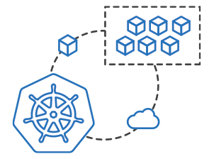
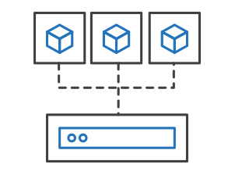
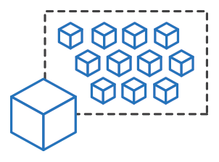
Azure Container Instances (ACI)
Easily run containers on Azure without managing servers
Run containers without managing servers
Increase agility with containers on demand
Secure applications with hypervisor isolation

Slide 14
Azure Container Instances
Great for:
Isolated Windows and Linux containers
Simple applications
Task automation
Build jobs
Hypervisor-level security
Custom sizes for CPU cores and memory
Public IP connectivity
Persistent storage
Co-scheduled groups
NOT great for:
Full container orchestration
Service discovery across multiple containers
Automatic scaling
Coordinated application upgrades
For all of above Microsoft recommend the Azure Kubernetes Service.
Notes:
Container Instances :
single command line to run containers –
just for experimentation purpose (lift and shift testing) or
burstable workload => Virtual Kubelet => https://channel9.msdn.com/Shows/Azure-Friday/Virtual-Kubelet-Introduction
No access to VM/network
Limited in term of
- Scaling,
- Coordinated application upgrade,
- Multi container scenarios
https://docs.microsoft.com/en-us/azure/container-instances/container-instances-overview
Additional details:
You get a single public IP, you can run multiple containers and you need to play with port.
can use it for testing or for simple application. Lift and shift scenario are also a good fit.

Slide 15
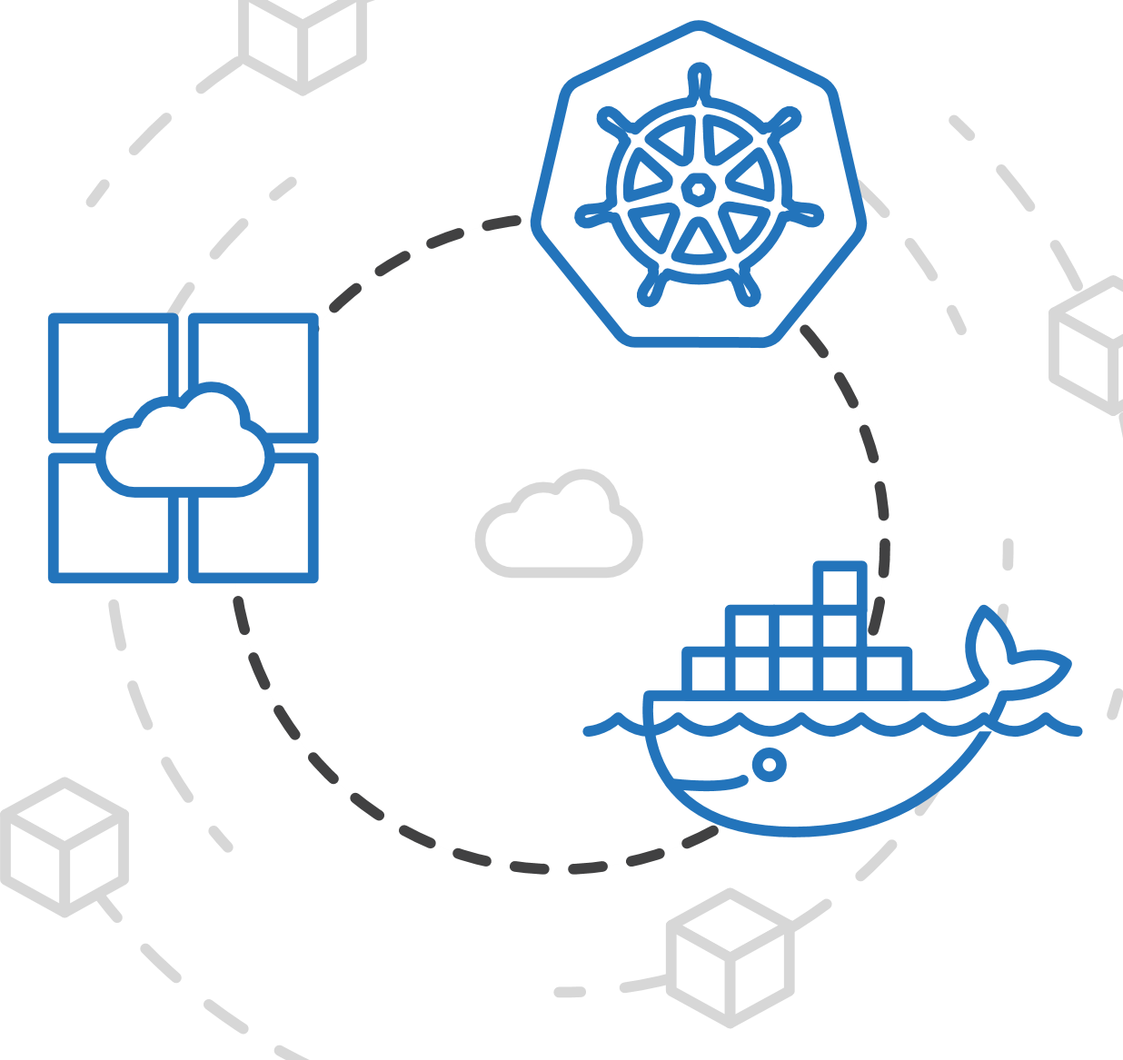
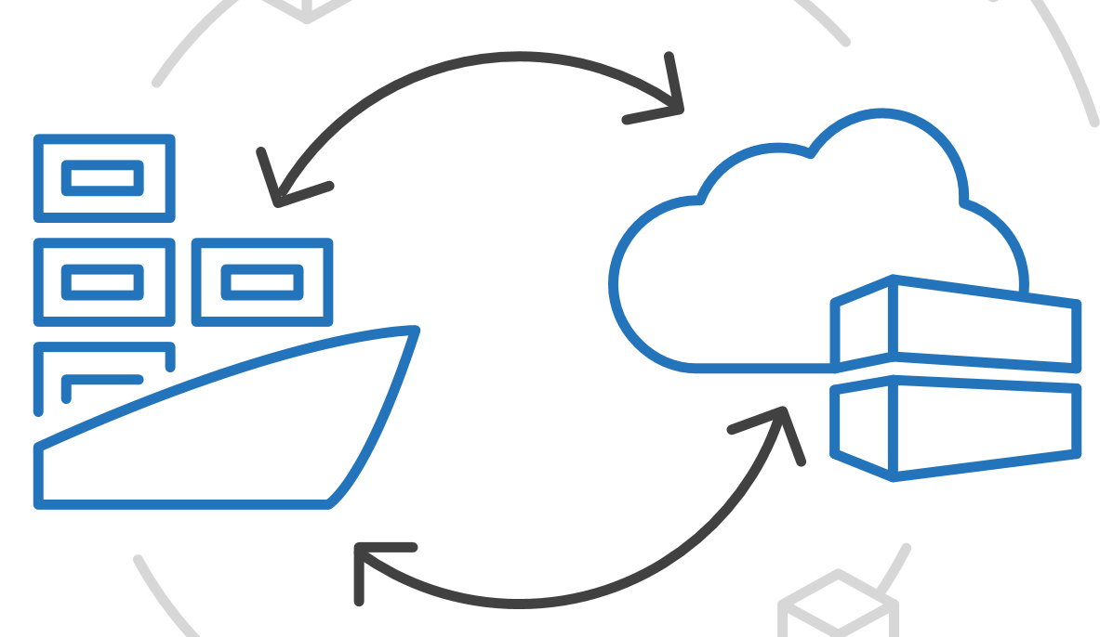
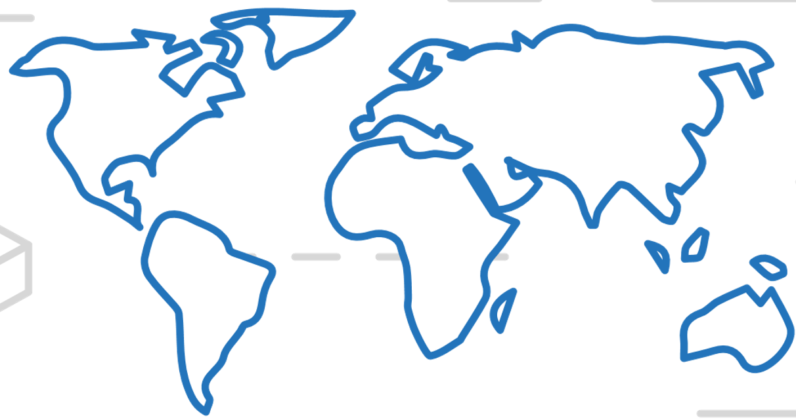
Azure Container Registry
Manage a Docker private registry as a first-class Azure resource
Manage images for all types of containers
Use familiar, open-source Docker CLI tools
Azure Container Registry geo-replication

Slide 16

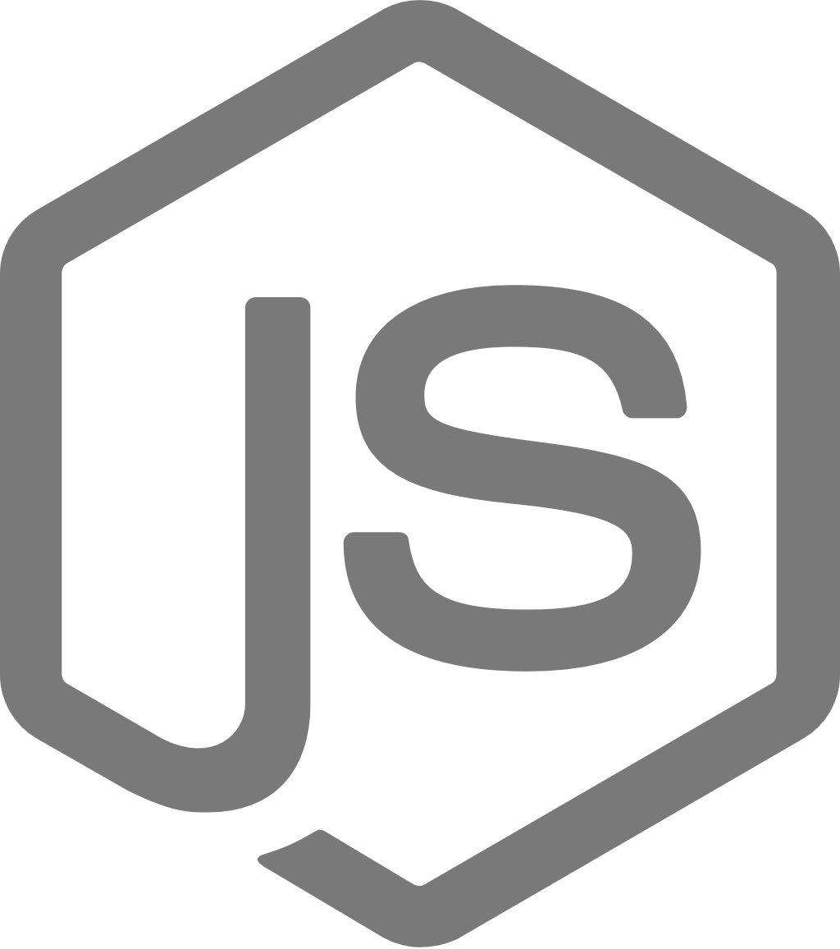
Azure Service Fabric
A microservices platform for business-critical applications
Build
Deploy
Operate
always-on, highly scalable microservice apps
</>
.NET
</>
Flexible infrastructure
Lifecycle management
24/7 availability & performance
Elastic scalability
Microservice and container orchestration
Security & compliance
Health & monitoring

Slide 17

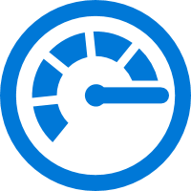
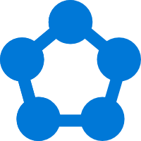


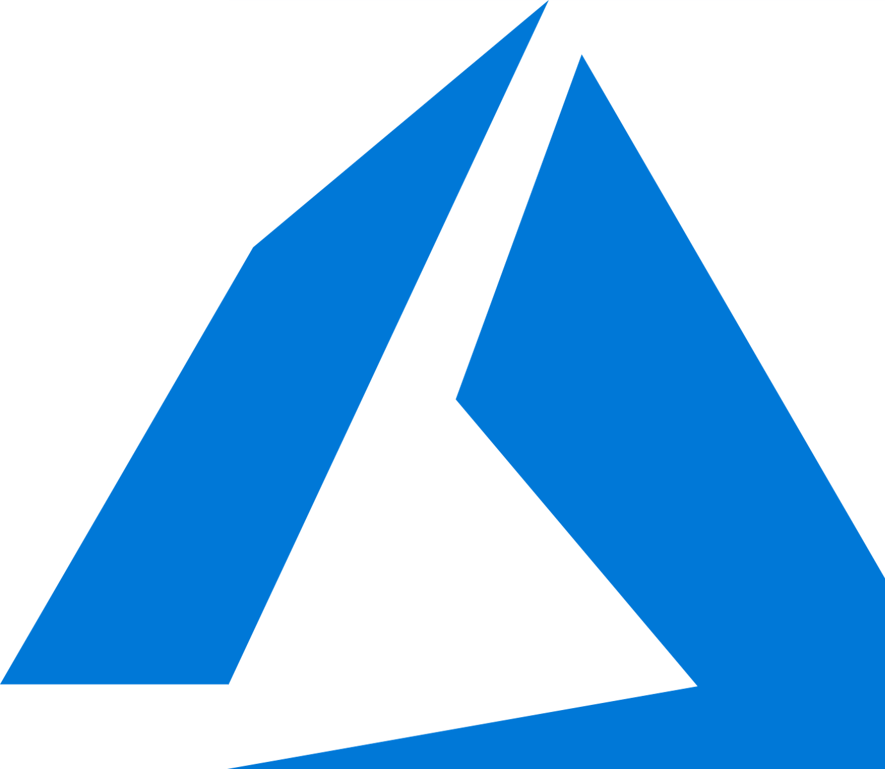


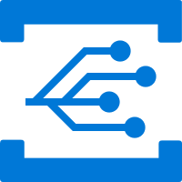

PaaS built on Service Fabric
Azure Database for MySQL
SQL Database
Power BI
Cosmos DB
Azure Monitor
Azure Database for PostgreSQL
Core Azure Services
Azure Container Registry
Dynamics
IoT Hub
Intune
Event Hub
Archive Storage
Event Grid
Cortana
Skype
Visual Studio Team Services
Stream Analytics
Notes:
In production for +7 years internally before it was externally released
Low-latency high throughput consumer facing service like Bing Cortana was built across 3 data centers using this technology. They recently lost an entire datacenter and the service didn’t blink
This are some examples of some of the services that we already have out in Azure that have been used for a while now
This platform has been battle hardened in our first party services for over 5 years
More importantly we are giving you not a version of the bits we use but the exact same bits that we run.
However, these 1st party service very low level Service Fabric APIs that may not be suitable for all developers
Over the last year, we have been working on developing higher level programming models and visual studio integration. You may see some rough edges in this area.
Azure core infrastructure itself runs on top of this platform
A transactionally consistent database service was built using this platform

Slide 18
Service Fabric capabilities
Application deployment services:
Rolling update with rollback - Upgrade and patch microservices within applications independently
Strong versioning
Side-by-side support for same application type
Leadership election
Naming service for discovery of applications
Partitioning support
Azure Load balancing and placement constraints
Consistent state replication framework
Ability to scale-out or scale-in your Service Fabric cluster
Now provides a serverless solution with Azure Service Fabric Mesh
Notes:
Key capabilities
Develop massively scalable applications, that are self-healing.
Develop with a "data center on your machine" approach. The local development environment is the same code that runs in the Azure data centers.
Develop applications composed of microservices, executables and other application frameworks of your choice such as ASP.NET, nodejs, etc.
Develop stateless and stateful (micro)services and make these highly reliable.
Simplify the design of your application, by using stateful (micro)services in place of caches and queues.
Deploy applications in seconds.
Deploy to Azure or to on-premise clouds running Windows Server with zero code changes. Write once and then deploy to any Service Fabric cluster.
Deploy applications at higher density than virtual machines, deploying hundreds or thousand of applications per machine.
Deploy different versions of the same application side-by-side, each independently upgradable.
Manage the lifecycle of your stateful applications without any downtime, including breaking and non-breaking upgrades.
Manage applications using .NET APIs, Powershell or REST interfaces.
Upgrade and patch microservices within applications independently.
Monitor and diagnose the health of your applications and set policies to perform automatic repairs.
Scale-up or scale-down your Service Fabric cluster easily, knowing that the applications scale according to the available resources.
Watch the self healing resource balancer orchestrate the redistribution of applications across the Service Fabric cluster to recover from failures and to optimize the distribution of load based on available resources.

Slide 19
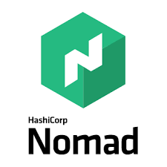


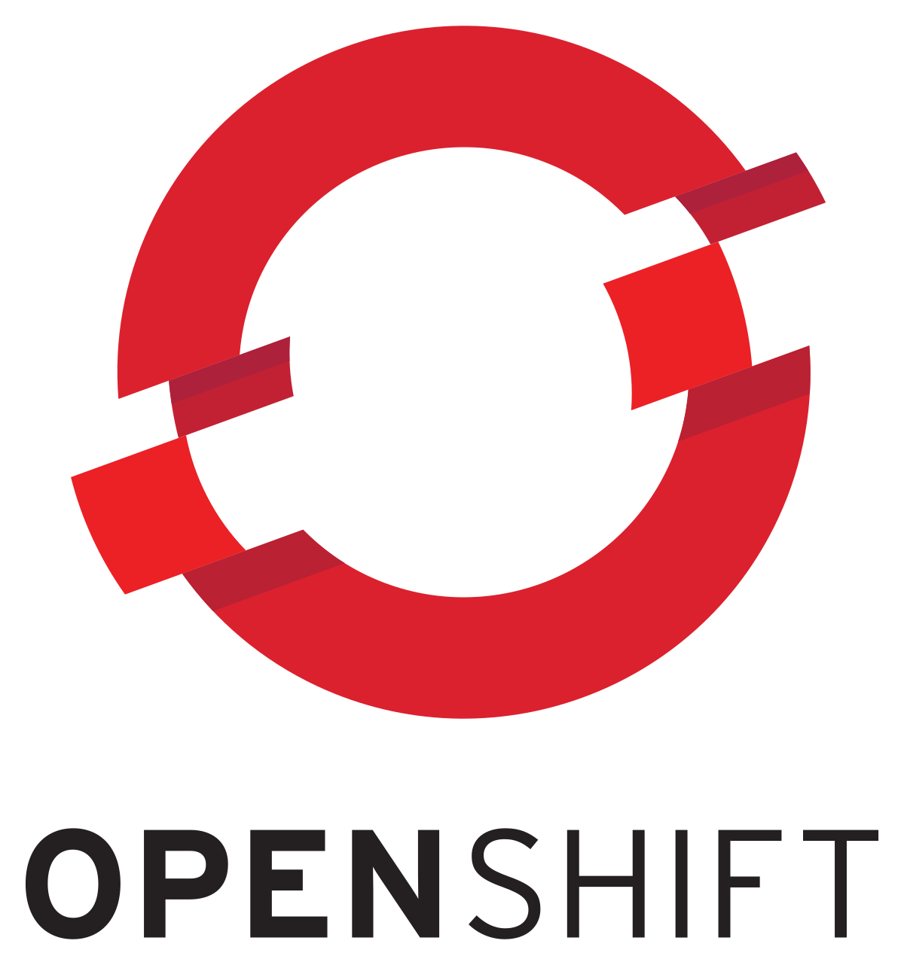
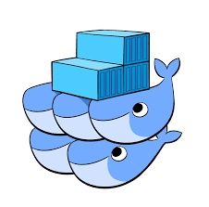
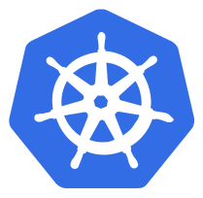
HashiCorp Nomad
Docker Support: Jobs specify the number of container instances needed and Nomad will handle placement and recover from failures automatically
Operationally Simple: Nomad combines features of both resource managers and schedulers into a single system
Multi-Datacenter and Multi-Region Aware
Flexible Workloads: Nomad has extensible support for task drivers, allowing it to run containerized, virtualized, and standalone applications
Built for Scale
Synergy with HashiCorp Terraform, Consul and Vault
Notes:
Nomad from HashiCorp, the makers of Vagrant and Consul, is another solution for managing containerized applications. Nomad schedules tasks defined in Jobs. It has a Docker driver which lets you define a running container as a task.
At its core, Nomad is a tool for managing a cluster of machines and running applications on them
Less complex than k8s architecturally
https://www.nomadproject.io/intro/index.html
Nomad models infrastructure as groups of datacenters which form a larger region. Scheduling operates at the region level allowing for cross-datacenter scheduling. Multiple regions federate together allowing jobs to be registered globally.
Users can easily start Docker containers, VMs, or application runtimes like Java. Nomad supports Linux, Windows, BSD and OSX, providing the flexibility to run any workload.
Nomad is optimistically concurrent, enabling all servers to participate in scheduling decisions which increases the total throughput and reduces latency to support demanding workloads. Nomad has been proven to scale to cluster sizes that exceed 10k nodes in real-world production environments.
Nomad's synergy and integration points with HashiCorp Terraform, Consul, and Vault make it uniquely suited for easy integration into an organization's existing workflows, minimizing the time-to-market for critical initiatives
Consiul is a service mesh

Slide 20
Mesosphere DC/OS
Integrate Platform for Data and Containers
Mesophere DC/OS is built on Apache Mesos. Mesos simplifies administration and maximizes resource utilization by abstracting the datacenter into a single giant computer
Run Docker and other container image types with the reliability of Mesos
Get the benefit of container network interface (CNI) support and GPU-based acceleration
Marathon is a framework for container and services orchestration typically used with Mesos and DC/OS
Kubernetes can also be used for orchestration on top of DC/OS
Typically used in large-scale clusters with node counts exceeding 10,000
https://info.mesosphere.com/The-Docker-vs-Kubernetes-vs-Apache-Mesos-Myth_RegistrationPage.html
Notes:
DC/OS by the company Mesosphere
Has been around for almost 10 years
Same as Kubernetes -> more than just container orchestration
Really good UI for managing workloads
REST API for automation
Advanced Enterprise support.
Mesosphere: name of the company –
DC/OS is the name of the distributed OS.
Marathon is the Orchestration layer (can be replaced by Kubernetes).
Apache Mesos is a distributed systems kernel that manages cluster resources and tasks
Can run Kubernetes on DC/OS
https://github.com/mesosphere/dcos-kubernetes-quickstart
Mesos does not support federation or multiple failure isolation regions.
With mesos you can run your datacenter and cloud as a single resource

Slide 21
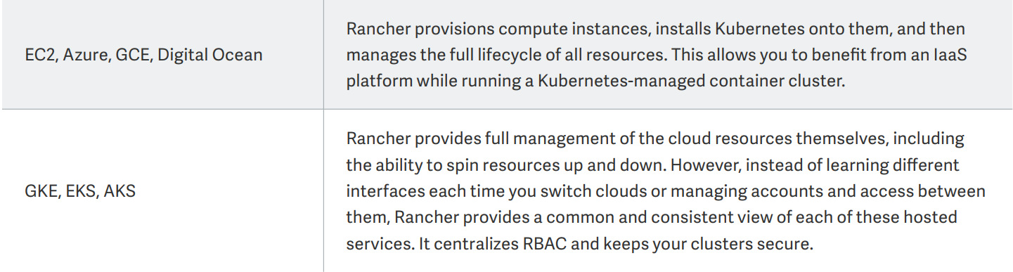
Rancher
OSS for delivering Kubernetes-as-a-Service
Enables you to deploy new clusters from scratch, launch EKS, GKE and AKS clusters, or even import existing Kubernetes clusters
“One Platform for Everyone who uses Kubernetes”
Useful for multi-cloud scenarios
Notes:
Rancher is a container orchestrator agnostic system, which provides a single pane of glass interface to managing applications. It supports Mesos, Swarm, Kubernetes, as well as its native system, Cattle.

Slide 22
Red Hat OpenShift
Extends the capabilities available in Kubernetes
“We package Kubernetes and include additional tooling as features that we find important and our users demand”
Enhances the enterprise user experience by adding features to enable rapid application development, easy deployment, and lifecycle maintenance
Can deploy and support anywhere Red Hat Enterprise Linux is deployed and supported (i.e. AWS, Azure, GCP, VMWare)
Istio available as a technology preview in OpenShift
Notes:
Red Hat OpenShift ships with Red Hat®Enterprise Linux® CoreOS for the Kubernetes master, and supports Red Hat Enterprise Linux for worker nodes. Red Hat OpenShift supports standard Docker and CRI-O runtimes.
Red Hat OpenShift includes hundreds of fixes to defect, security, and performance issues for upstream Kubernetes in every release
Red Hat OpenShift ships with an integrated, private container registry
Red Hat OpenShift includes streamlined workflows to help teams get to production faster, including built-in Jenkins pipelines and our source-to-image technology to go straight from application code to container.

Slide 23
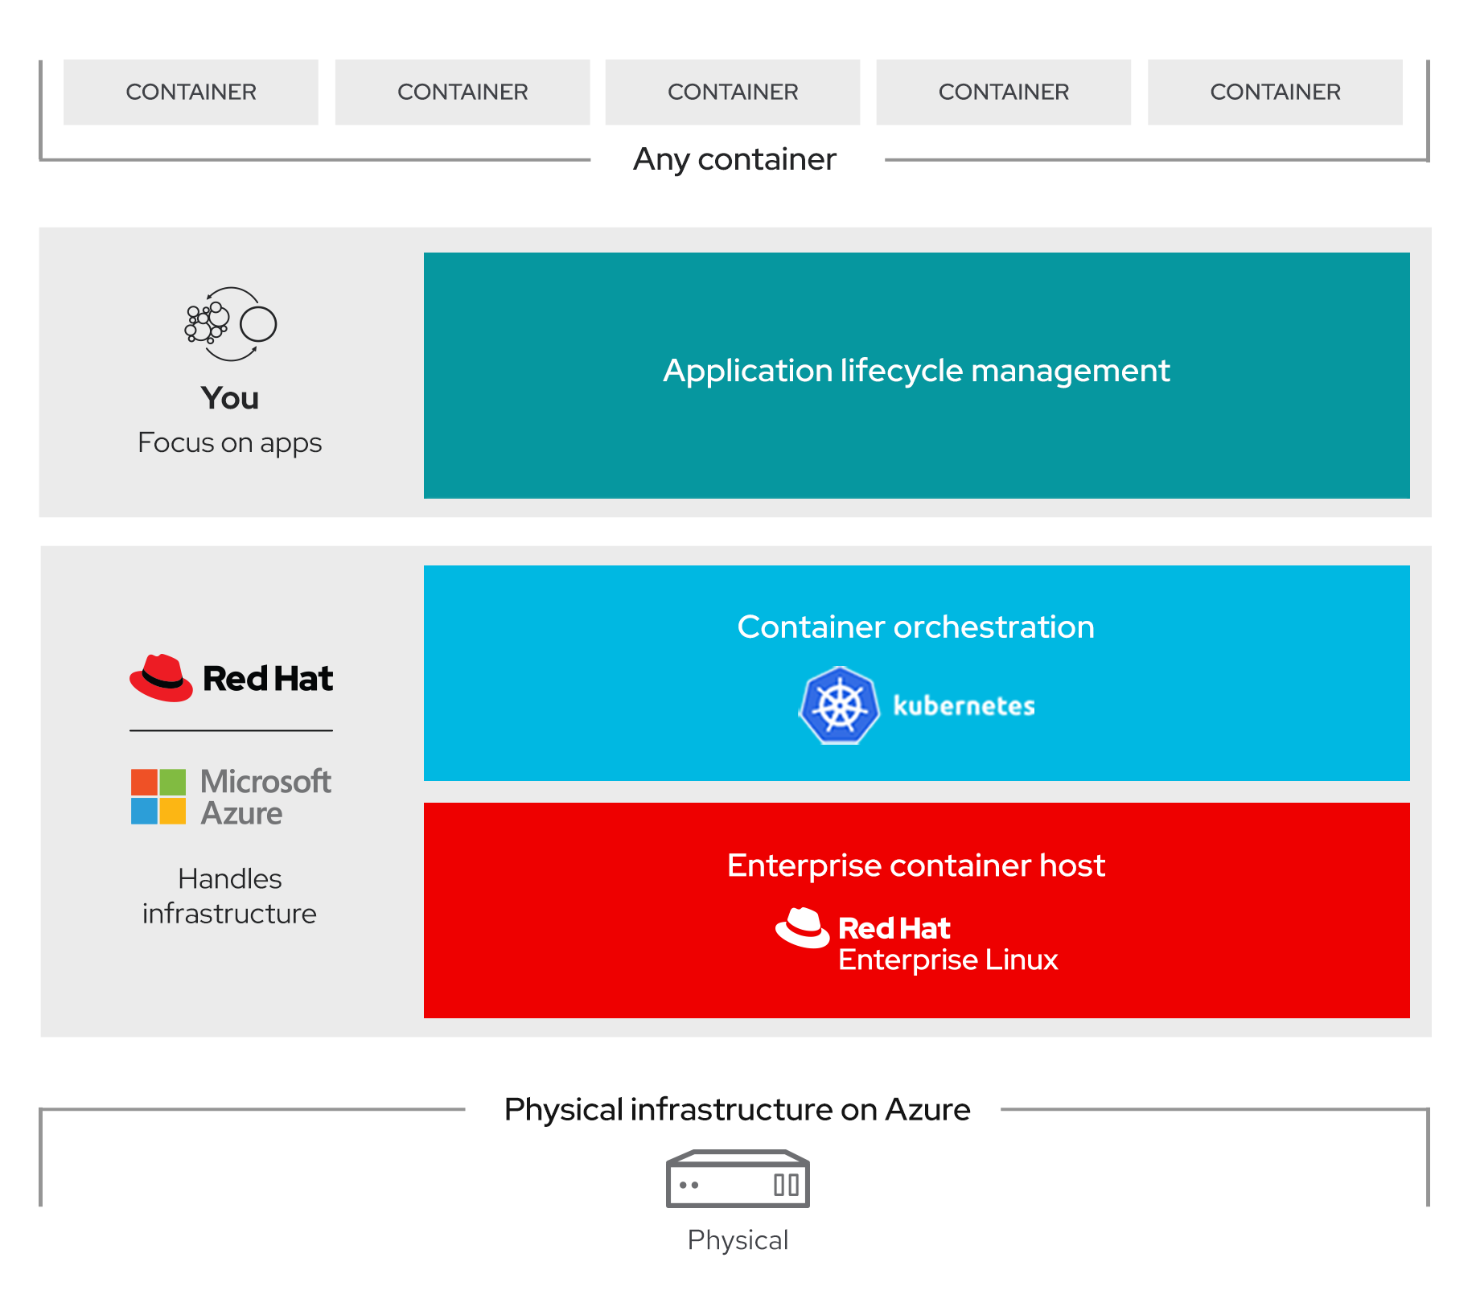
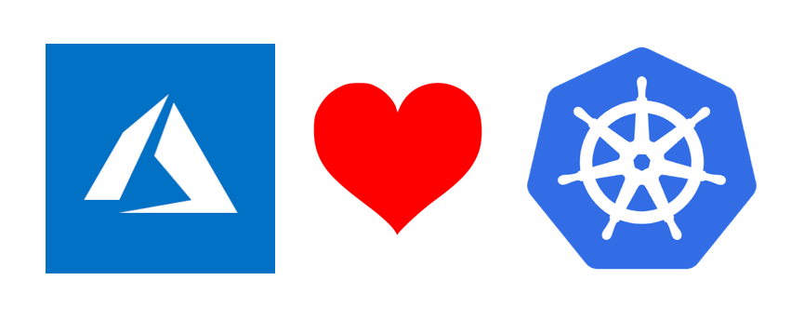
Microsoft Azure Red Hat OpenShift
Azure Red Hat OpenShift is a fully managed service of Red Hat OpenShift on Azure, jointly, engineered, operated and supported by Microsoft and Red Hat
Notes:
Azure Active Directory integration
integrated support experience and 99.9% uptime SLA
Host in all the regions supported by Microsoft Azure
Cost: Starts at $16,000/yr
https://www.openshift.com/products/azure-openshift

Slide 24
Docker Swarm
Docker Swarm is native clustering for Docker using the native Docker API
Swarm mode is a Docker feature that provides built in container orchestration capabilities, including native clustering of Docker hosts and scheduling of container workloads
The workflow for managing containers on a Docker Swarm is almost identical to what it would be on a single container host
Uses the same artifacts, so you can run your app across 50 containers in a 20-node swarm and the functionality will be the same as when you run it in a single container on your laptop
Notes:
Docker Swarm is the Docker Inc. solution. It has been re-architected recently and is based on SwarmKit. It is embedded with the Docker Engine.
Docker Swarm is a separate product which you can use to cluster multiple Docker hosts.
Prior to Docker version 1.12 it was the only native Docker option for clustering hosts, and it needed a lot of additional setup for distributed state, service discovery and security.
You don’t need to install anything extra to run in swarm mode
On the first, you run docker swarm init to initialize the swarm, and on the others you run docker swarm join to join the swarm
Docker has HA, security, scale and resilience built in. Your docker journey can lead you to production if you so choose
The initial setup is straightforward. Given its simplicity, Docker Swarm works great in small environments but has also been successfully scaled for large environments with up to 30,000 containers. With Docker Enterprise Edition, you can deploy apps using both Docker Swarm and Kubernetes within the same platform.

Slide 25
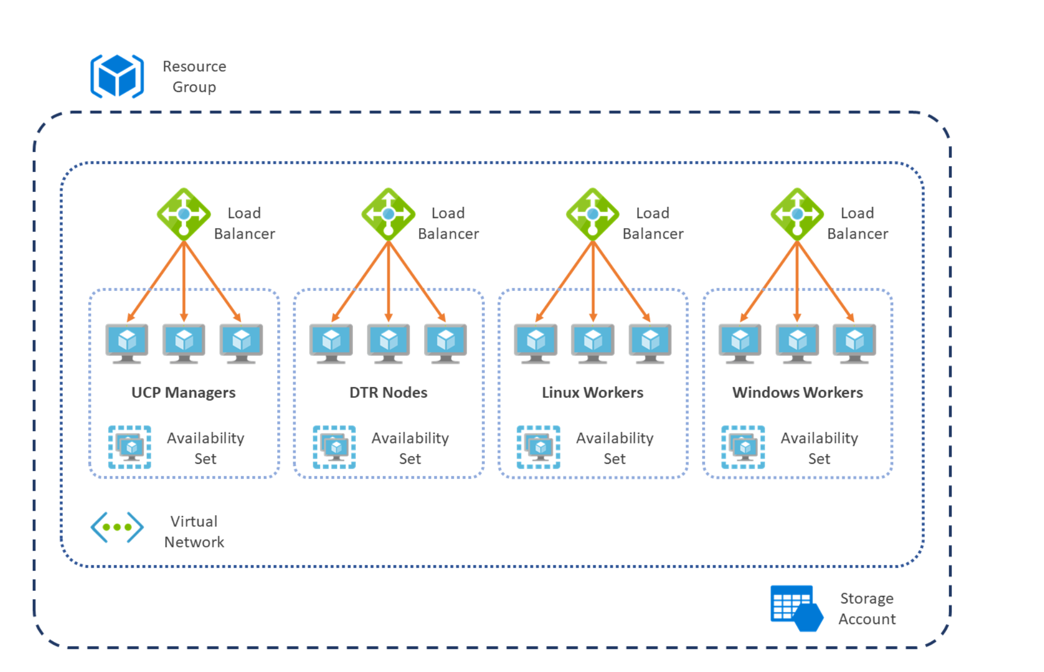

Docker Certified Infrastructure for Azure
https://success.docker.com/article/certified-infrastructures-azure
Docker Certified Infrastructure is Docker's prescriptive approach to deploying Docker Enterprise on a range of infrastructure choices
Notes:
Docker has HA, security, scale and resilience built in. Your docker journey can lead you to production if you so choose
Docker daemon can use Swarm to transparently scale to multiple hosts

Slide 26
Kubernetes Overview of Kubernetes

Slide 27
Kubernetes
Kubernetes is "an open-source software for automating deployment, scaling, and management of containerized applications“
Kubernetes, in Greek κυβερνήτης, means the Helmsman, or pilot of the ship
Keeping with the maritime theme of Docker containers, Kubernetes is the pilot of a ship of containers
Notes:
Originally designed by Google and is now maintained by the Cloud Native Computing Foundation (CNCF).
Google still actively involved
Kubernetes v1.0 was released on July, 2015 by Joe Beda, Brendan Burns and Craig McLuckie
Most discussed repo in GitHub last year.
Over 1,700 authors and releases every three month
Large-scale cluster management at Google with Borg

Slide 28
Kubernetes
The de-facto orchestrator
Portable
Public
Private
Hybrid
multi-cloud
Extensible
Modular
pluggable
Hookable
composable
Self-healing
Auto-placement
auto-restart
auto-replication
auto-scaling
Notes:
Kubernetes is an open-source platform designed to automate deploying, scaling, and operating application containers.
The approach is like a Desired State: you tell what you want (declarative Yaml files) – K8s makes it happen
https://kubernetes.io/docs/concepts
https://docs.microsoft.com/en-us/azure/container-service/kubernetes/container-service-intro-kubernetes or
https://docs.microsoft.com/en-us/azure/aks/intro-kubernetes

Slide 29
Kubernetes
Empowering you to do more
Deploy your applications quickly and predictably
Scale your applications on the fly
Roll out new features seamlessly
Limit hardware usage to required resources only
Notes:
Kubernetes is an open-source platform designed to automate deploying, scaling, and operating application containers.
The approach is like a Desired State: you tell what you want (declarative Yaml files) – K8s makes it happen
https://kubernetes.io/docs/concepts
https://docs.microsoft.com/en-us/azure/container-service/kubernetes/container-service-intro-kubernetes or https://docs.microsoft.com/en-us/azure/aks/intro-kubernetes

Slide 30
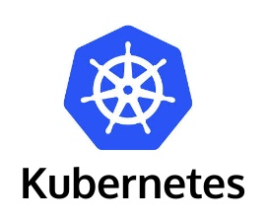
Kubernetes Terminology
Cluster
- Control Plane (Master Node) schedules containers
- Worker nodes run containers
Kubectl
- main command line tool to manage your cluster

Slide 31
Kubernetes Terminology
Pod – one or more containers. Smallest unit of deployment
ReplicaSet – Multiple instances of a pod
Deployment – defines desired state of Pods
Service – Load Balancing. Locates Pods and routes traffic
Namespace – Isolation. Used to isolate applications, version or environments
YAML – Declarative Deployments
HELM – package manager for kubernetes

Slide 32
Kubernetes Architecture
Internet
Proxies route traffic across nodes and Pods
kubectl
Command line utility to manage Kubernetes
Control Plane manages the entire cluster
Worker node
Kubelet
Kube-proxy
Control Plane / Master node
Container Runtime
Kublets monitor the Node and Pods
Pod
Pod
API Server
Entry point for REST commands to the Control Plane
Worker nodes host containerized workloads
kube-controller-manager (replication, namespaces, serviceaccounts,…)
scheduler
Worker node
Kubelet
Pods are collections of containers deployed as a single unit
Deploys containers across the cluster based upon rules
Kube-proxy
Handles routine tasks in the cluster
Container Runtime
etcd
Pod
Pod
Key-value data store that maintains cluster state
Notes:
In its simplest form, Kubernetes is made of a central manager (aka master) and some worker.
The manager runs an API server, a scheduler, various controllers and a storage system to keep the state of the cluster, container settings, and the networking configuration.
Master Components:
kube-apiserver
Component on the master that exposes the Kubernetes API. It is the front-end for the Kubernetes control plane.
It is designed to scale horizontally – that is, it scales by deploying more instances.
kube-controller-manager
Component on the master that run the controllers. Logically, each controller is a separate process, but to reduce complexity, they are all compiled into a single binary and run in a single process.
These controllers include:
Node Controller: Responsible for noticing and responding when nodes go down.
Replication Controller: Responsible for maintaining the correct number of pods for every replication controller object in the system.
Endpoints Controller: Populates the Endpoints object (that is, joins Services & Pods).
Service Account & Token Controllers: Create default accounts and API access tokens for new namespaces
cloud-controller-manager
Component on the master that run the
These controllers include:
N: Responsible for.
Kube-scheduler
Component on the master that watches newly created pods that have no node assigned, and selects a node for them to run on.
Factors taken into account for scheduling decisions include individual and collective resource requirements, hardware/software/policy constraints, affinity and anti-affinity specifications, data locality, inter-workload interference and deadlines.
etcd
Consistent and highly-available key value store used as Kubernetes’ backing store for all cluster data
Node Components:
Kubelet
An agent that runs on each node in the cluster. It makes sure that containers are running in a pod.
The kubelet is the Kubernetes agent that processes the orchestration requests from the cluster master and scheduling of running the requested containers.
The kubelet takes a set of PodSpecs that are provided through various mechanisms and ensures that the containers described in those PodSpecs are running and healthy. The kubelet doesn’t manage containers which were not created by Kubernetes.
Kube-proxy
A network proxy that runs on each node in your cluster, implementing part of the Kubernetes Service concept.
Virtual networking is handled by the kube-proxy on each node. The proxy routes network traffic and manages IP addressing for services and pods.
Maintains network rules on nodes. These network rules allow network communication to your Pods from network sessions inside or outside of your cluster.
Uses the operating system packet filtering layer if there is one and it’s available. Otherwise, kube-proxy forwards the traffic itself.
Container Runtime
The container runtime is the component that allows containerized applications to run and interact with additional resources such as the virtual network and storage. In AKS, Moby is used as the container runtime.
-- As Solomon rightly said “Docker uses the Moby Project as an open R&D lab”.
The container runtime is the software that is responsible for running container.
Kubernetes supports several container runtimes: Docker, containerd, cri-o, rktlet and any implementation of the Kubernetes CRI (Container Runtime Interface).
Addons
DNS, Metrics Server (enables monitoring and performance analysis), Dashboard, Logging. Addons use Kubernetes resources to implement cluster features.

Slide 33
What are Pods?
Deployment
Replica Set
POD
Pods are the smallest building block in Kubernetes…
A collection of co-located containers and volumes
Running in the same execution environment
Managed as a single atomic unit
You never directly run a container, instead you run a Pod
Apps running in a Pod share the same IP, port and communicate using native interprocess communication channels
Apps in different Pods are isolated from each other; they have different IP addresses, different hostnames, etc.
Pods are immutable - if a change is made to a pod definition, a new pod is created, and the old pod is deleted
Container
Notes:
A Pod represents a collection of application containers and volumes running in the same execution environment. Pods, not containers, are the smallest deployable artifact in a Kubernetes cluster. This means all of the containers in a Pod always land on the same machine.
Each container within a Pod runs in its own cgroup, but they share a number of Linux namespaces.
Kubernetes uses pods to run an instance of your application. A pod represents a single instance of your application. Pods typically have a 1:1 mapping with a container, although there are advanced scenarios where a pod may contain multiple containers. These multi-container pods are scheduled together on the same node, and allow containers to share related resources.
When you create a pod, you can define resource limits to request a certain amount of CPU or memory resources. The Kubernetes Scheduler tries to schedule the pods to run on a node with available resources to meet the request. You can also specify maximum resource limits that prevent a given pod from consuming too much compute resource from the underlying node. A best practice is to include resource limits for all pods to help the Kubernetes Scheduler understand which resources are needed and permitted.
A pod is a logical resource, but the container(s) are where the application workloads run. Pods are typically ephemeral, disposable resources, and individually scheduled pods miss some of the high availability and redundancy features Kubernetes provides. Instead, pods are usually deployed and managed by Kubernetes Controllers, such as the Deployment Controller.

Slide 34
Declarative Configuration
Pods are defined in a Pod manifest: A readable, declarative text-file
Kubernetes itself thrives on declarative configuration…
Capture the desired state of a Kubernetes object in a configuration
Submit that configuration to a service that takes actions to ensure the desired state becomes the actual state
Provides for a more manageable, dynamic and reliable system
Contrast with imperative configuration where you explicitly instruct the system what to do, typically by issuing a series of commands

Slide 35
The Pod Lifecycle
Let’s say you want to provision a container in Kubernetes
From the Kubectl console, you…
Make a Pod request to an API server using a Pod definition (YAML) file
The API server saves the configuration data to the persistent storage (ETCD store)
The scheduler finds the unscheduled Pod and schedules it to an available node
The Kubelet sees the Pod scheduled and fires up Docker
Docker runs the container
The Kubelet manages objects on the worker nodes
The entire lifecycle state of the Pod is stored in the Etcd store

Slide 36
How Pods Work
kubectl
Worker node 1
Instruct the Master node to provision 2 replicas of a pod
Kubelet
Master node
Container Runtime
API Server
kube-controller-manager
scheduler
Worker node 2
Store pod specification
Kubelet
Container Runtime
etcd
Notes:
Administrator sends pod creation request using kubectl command line tool.
Pod specification is stored in etcd.
In production scenarios you don’t create a pod directly, since it cannot be scheduled on a different node automatically when the node is down and you cannot ensure exact number of replicas are running in the cluster.
You should use a controller like ReplicaSet or Deployment to better manage availability and scalability of your pods.

Slide 37
How Pods Work
kubectl
Worker node 1
Kubelet
Master node
Container Runtime
API Server
kube-controller-manager
scheduler
Worker node 2
Assigns a node for each pod
Kubelet
Container Runtime
1. Pod = Worker Node 1
2. Pod = Worker Node 2
etcd
Notes:
2- Scheduler watches newly created pods that have no node assigned, and selects a node for them to run on.
Factors taken into account for scheduling decisions include individual and collective resource requirements, hardware/software/policy constraints, affinity and anti-affinity specifications, data locality, inter-workload interference and deadlines.
https://kubernetes.io/docs/concepts/overview/components/#kube-scheduler

Slide 38
How Pods Work
kubectl
Worker node 1
The Kubelets check if there are pods assigned and starts them
Kubelet
Master node
Container Runtime
Pod
API Server
kube-controller-manager
scheduler
Worker node 2
Kubelet
Container Runtime
1. Pod = Worker Node 1
2. Pod = Worker Node 2
Pod
etcd
Notes:
3- The kubelet takes a set of PodSpecs that are provided through various mechanisms (primarily through the apiserver) and ensures that the containers described in those PodSpecs are running and healthy.
https://kubernetes.io/docs/reference/command-line-tools-reference/kubelet/
https://kubernetes.io/docs/concepts/overview/components/#kubelet

Slide 39
How Pods Work
kubectl
Kube-controller-manager ensures the correct number of pods is running in the cluster
Worker node 1
Kubelet
Master node
Container Runtime
Pod
API Server
kube-controller-manager
scheduler
Worker node 2
Kubelet
Container Runtime
1. Pod = Worker Node 1
2. Pod = Worker Node 2
Pod
etcd
Notes:
Kube-controller-manager is a daemon that embeds the core control loops shipped with Kubernetes.
In applications of robotics and automation, a control loop is a non-terminating loop that regulates the state of the system.
In Kubernetes, a controller is a control loop that watches the shared state of the cluster through the apiserver and makes changes attempting to move the current state towards the desired state.
These controllers include:
Replication Controller: Responsible for maintaining the correct number of pods for every replication controller object in the system.
Node Controller
Endpoints Controller
Service Account & Token Controllers
https://kubernetes.io/docs/concepts/overview/components/#kube-controller-manager
https://kubernetes.io/docs/reference/command-line-tools-reference/kube-controller-manager/

Slide 40
What are Replica Sets?
Deployment
Replica Set
POD
A Pod is essentially a one-off singleton instance
Replica Sets are a Kubernetes object that manage Pods
Redundancy – allow for failure
Scale – allow for more requests to be processed
They monitor the cluster and ensure the desired number of Pods are correctly running
If no Pods are provisioned, the Replica Set Controller will schedule them
If actual count drops below the desired, the controller will schedule replacements
If you exceed the desired count, the controller will destroy them
Replica sets are created by and managed through Kubernetes Deployment objects
Container
Notes:
A ReplicaSet acts as a cluster-wide Pod manager, ensuring that the right types and number of Pods are running at all times.
Because ReplicaSets make it easy to create and manage replicated sets of Pods, they are the building blocks used to describe common application deployment patterns and provide the underpinnings of self-healing for our applications at the infrastructure level. Pods managed by ReplicaSets are automatically rescheduled under certain failure conditions, such as node failures and network partitions.
The easiest way to think of a ReplicaSet is that it combines a cookie cutter and a desired number of cookies into a single API object.
When we define a ReplicaSet, we define a specification for the Pods we want to create (the “cookie cutter”).

Slide 41
What are Deployments?
Deployment
Replica Set
POD
A deployment defines the lifecycle of an application
Is made up of pods
Controls Replica Sets
Includes the functionality to update the desired state
Rolling updates are included
Provides fine-grained control over how and when a new pod version is rolled out as well as rolled back to a previous state
With a deployment, you can declaratively state how many instances of your pod you would like, you can define rollout strategies, gain self-healing behavior, and much more. This provides a scalable platform to deploy your application.
Container
Notes:
Deployments are really are what it is all about in a Kubernetes environment.
The deployments instruct the cluster how to create and scale applications.
The deployment controller will monitor instances of an application, and, if it falls short, it will automatically create new instances.
Deployments allow for the creation of multiple replica sets for rolling updates or a rollback
A deployment represents one or more identical pods, managed by the Kubernetes Deployment Controller. A deployment defines the number of replicas (pods) to create, and the Kubernetes Scheduler ensures that if pods or nodes encounter problems, additional pods are scheduled on healthy nodes.
You can update deployments to change the configuration of pods, container image used, or attached storage. The Deployment Controller drains and terminates a given number of replicas, creates replicas from the new deployment definition, and continues the process until all replicas in the deployment are updated.
Most stateless applications in AKS should use the deployment model rather than scheduling individual pods. Kubernetes can monitor the health and status of deployments to ensure that the required number of replicas run within the cluster. When you only schedule individual pods, the pods aren't restarted if they encounter a problem, and aren't rescheduled on healthy nodes if their current node encounters a problem.
If an application requires a quorum of instances to always be available for management decisions to be made, you don't want an update process to disrupt that ability. Pod Disruption Budgets can be used to define how many replicas in a deployment can be taken down during an update or node upgrade. For example, if you have 5 replicas in your deployment, you can define a pod disruption of 4 to only permit one replica from being deleted/rescheduled at a time. As with pod resource limits, a best practice is to define pod disruption budgets on applications that require a minimum number of replicas to always be present.
Deployments are typically created and managed with kubectl create or kubectl apply. To create a deployment, you define a manifest file in the YAML (YAML Ain't Markup Language) format. The following example creates a basic deployment of the NGINX web server. The deployment specifies 3 replicas to be created, and that port 80 be open on the container. Resource requests and limits are also defined for CPU and memory.
apiVersion: apps/v1
kind: Deployment
metadata:
name: nginx
spec:
replicas: 3
selector:
matchLabels:
app: nginx
template:
metadata:
labels:
app: nginx
spec:
containers:
- name: nginx
image: nginx:1.15.2
ports:
- containerPort: 80
resources:
requests:
cpu: 250m
memory: 64Mi
limits:
cpu: 500m
memory: 256Mi

Slide 42
Azure Kubernetes Engine
Open source: https://github.com/Azure/aks-engine
Easiest way to provision a self-managed Kubernetes cluster on Azure
Leverages Azure Resource Manager (ARM), to help you create, destroy and maintain clusters provisioned with basic IaaS resources in Azure
Allows you to customize Deployments
Deploying into existing virtual networks
Utilizing multiple agent pools
Notes:
AKS Engine is also the library used by AKS for performing these operations to provide managed service implementations.
https://azure.microsoft.com/en-us/updates/public-preview-of-azure-monitor-for-containers-support-for-aks-engine/
https://kubernetes.io/docs/setup/turnkey/azure/
A whole lot more flexibility but more things to manage as well.
The core of the Azure Kubernetes Service is open source and available on GitHub for the community to use and contribute to: AKS-Engine
Some community contributions to AKS-Engine may even become features of the Azure Kubernetes Service.

Slide 43
Azure Kubernetes Service
Simplify the deployment, management, and operations of Kubernetes
Deploy and manage Kubernetes with ease
Scale and run applications with confidence
Secure your Kubernetes environment
Accelerate containerized application development
Work how you want with open-source tools & APIs
Set up CI/CD in a few clicks
Notes:
Managed Kubernetes as a Service => no access to master machine
Kubernetes is the orchestrator
AKS is the clustering platform
Easily provision clusters via the Azure portal and Azure CLI, or with infrastructure as code tools such as Azure Resources Manager and Terraform.
Simplify cluster maintenance with automated upgrades and scaling.
Gain operational visibility into your managed Kubernetes environment with control plane telemetry, log aggregation, and container health visible as part of the Azure portal, automatically configured for AKS clusters

Slide 44
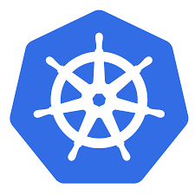
Why Azure Kubernetes Service?
Easy to use
Fastest path to Kubernetes (K8s) on Azure
Up and running with 3 simple commands
AKS is free - you only pay for the agent nodes within your clusters, not for the masters
Easy to manage
The K8s masters are managed by Azure
Automated upgrades and patching
Easily scale the cluster up and down
Self-healing control plane
Uses Open APIs
100% upstream Kubernetes
Notes:
Reference: https://azure.microsoft.com/en-us/pricing/details/kubernetes-service/
Azure Kubernetes Service (AKS) is a free container service that simplifies the deployment, management, and operations of Kubernetes as a fully managed Kubernetes container orchestrator service.
Paying for only the virtual machines, and associated storage and networking resources consumed makes AKS the most efficient and cost-effective container service on the market.
No SLA, but have a SLO 99.5%

Slide 45
AKS Compliance and Certification
Azure Kubernetes Service (AKS) has been CNCF certified as Kubernetes conformant.
Azure Kubernetes Service (AKS) is compliant with SOC, ISO, and PCI DSS.
Notes:
Reference: https://gallery.technet.microsoft.com/Overview-of-Azure-c1be3942

Slide 46

Demonstration: Kubernetes Cluster in Azure Kubernetes Service
Deploy Kubernetes clusters in Azure Kubernetes Service
Deploy NGINX container into Kubernetes cluster
Notes:
Please refer to Module 5 – Demos document section Demo 1 for detail instructions about the demo.

Slide 47
Azure Kubernetes Service
Windows Support
AKS clusters with Windows node pools must use the Azure CNI (advanced) networking model
AKS cluster supporting Windows containers will be composed of a Windows node pool and a Linux node pool
Use Node Taints to prevent Linux pods from deploying to Windows Nodes.
Use Node Selector to specify on which nodes the workloads must be deployed
Notes:
https://docs.microsoft.com/en-us/azure/aks/windows-faq#what-network-plug-ins-are-supported
Taints: https://kubernetes.io/docs/concepts/scheduling-eviction/taint-and-toleration/
A Taint prevents Kubernetes from deploying pods to a Node UNLESS it’s configuration has a Toleration overriding the Taint
tolerations:
- key: kubernetes.io/os
operator: Equal
value: windows
effect: NoSchedule
In YAML file, a node selector will then be specified for workloads that need to be deployed on a specific OS:
nodeSelector:
"beta.kubernetes.io/os": windows
When Windows Nodes are setup with a Taint then Linux pods will deploy only yo linux nodes without changes. To Deploy Windows Pods you MUST add a Toleration to override the Taint AND a Node Selector to choose the Windows Nodes.
(see link below for a complete example)
https://docs.microsoft.com/en-us/azure/aks/windows-container-cli
https://docs.microsoft.com/en-us/azure/aks/faq#can-i-run-windows-server-containers-on-aks

Slide 48

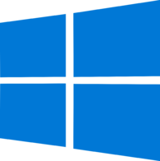
Deploying Windows Pods
kubectl
Linux Node
Instruct the Control Plane to provision a pod
kubernetes.io/os=linux
Control Plane
API Server
scheduler
Windows Node
Store pod specification
kubernetes.io/os=windows
Taint:
kubernetes.io/os=windows:NoSchedule
etcd

Slide 49
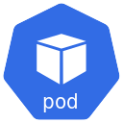
Deploying Windows Pods
kubectl
Pod Manifest
spec:
tolerations:
- key: kubernetes.io/os
operator: Equal
value: windows
effect: NoSchedule
nodeSelector:
kubernetes.io/os: windows
Linux Node
A Pods Tolerations informs Kubernetes to include Nodes with the same Taint
kubernetes.io/os=linux
Control Plane
A Pods Node Selector informs Kubernetes to only include Nodes with the same Label
API Server
scheduler
Windows Node
Assigns a node for each pod
kubernetes.io/os=windows
Taint:
kubernetes.io/os=windows:NoSchedule
The Node Taint prevents the node from being considered
etcd
Notes:
Because of the Node TAINT, the default behavior is that pods are scheduled to deploy to Linux Nodes only. No changes needed to deploy Linux Pods.
<CLICK>
To allow the scheduler to consider Windows nodes, the Pod manifest must include a TOLERATION that overrides the node TAINT.
<CLICK>
To have the scheduler consider only the Windows Nodes, the Pod Manifest must also include a NODE SELECTOR specifying nodes running on Windows (kubernetes.io/os = windows)

Slide 50
Demonstration: Windows Containers
Deploy a Windows Container
Notes:
Please refer to Module 5 – Demos document section Demo 2 for detail instructions about the demo.

Slide 51
Minikube for local k8s development
Runs a single-node Kubernetes cluster inside a VM on your laptop, allowing you to try out Kubernetes or develop with it day-to-day
Supports Kubernetes features such as:
DNS
NodePorts
ConfigMaps and Secrets
Dashboards
Container Runtime: Docker, rkt and CRI-O
Enabling CNI (Container Network Interface)
Ingress
Notes:
Minikube is a tool that makes it easy to run Kubernetes locally.
Minikube runs a single-node Kubernetes cluster inside a VM on your laptop for users looking to try out Kubernetes or develop with it day-to-day. https://kubernetes.io/docs/getting-started-guides/minikube/
It is not a full K8s cluster but you have some of the features:
DNS
Dasbboard
Different container : Docker, rkt or CRI-) compliant runtimes.
Custom networking setup: CNI
Silent Note:
CRI-O => Interface/specification to build a container runtime.
It is meant to provide an integration path between OCI conformant runtimes and the kubelet. Specifically, it implements the Kubelet Container Runtime Interface (CRI) using OCI conformant runtimes. The scope of CRI-O is tied to the scope of the CRI.
CNI: consists of a specification and libraries for writing plugins to configure network interfaces in Linux containers, along with a number of supported plugins

Slide 52
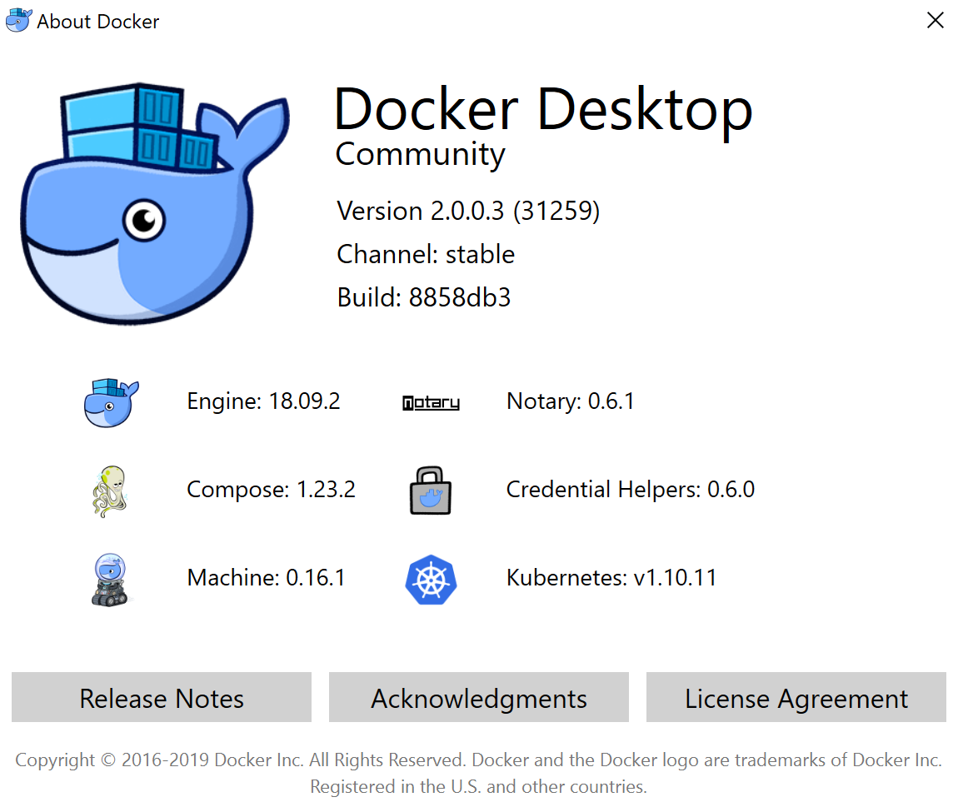
Docker + k8s integration
Since early 2018, Docker platform integrates with Kubernetes
Developers and operators can build apps with Docker and seamlessly test and deploy them using both Docker Swarm and Kubernetes
Kubernetes support comes with both Docker Enterprise Edition (EE) & Docker Community Edition (CE)
Notes:
Now you can use docker desktop to work with a local k8s cluster, issue is you are stuck with whatever version of Kubernetes the latest docker desktop version ships with
https://stackoverflow.com/questions/51209870/minikube-vs-kubernetes-in-docker-for-windows

Slide 53
Demonstration: Working with Kubernetes Minikube
Minikube Overview
Working with Deployments, and Replica Set
Notes:
Please refer to Module 5 – Demos document section Demo 3 for detail instructions about the demo.

Slide 54

Lab 5: Orchestrators (windows vm)
Labs
Duration : 60 min
Lab 5: MiniKube (linux vm)
Duration : 75 min
Notes:
60 min + 75 Min

Slide 56

Deprecation of Azure Container Services
ACS with Kubernetes, migrate to Azure Kubernetes Service or to the open-source aks-engine
ACS with Docker, move to the Basic or Standard/Advanced Docker Enterprise Edition and reference the Docker Certified Infrastructure for Azure approach
ACS with DC/OS, move to the Mesosphere DC/OS Enterprise or Mesosphere DC/OS Open Source solution template
ACS
January 31, 2020

